Slide 1
Data Science Air Pollution Assignment
Katerina Chochou

Slide 2
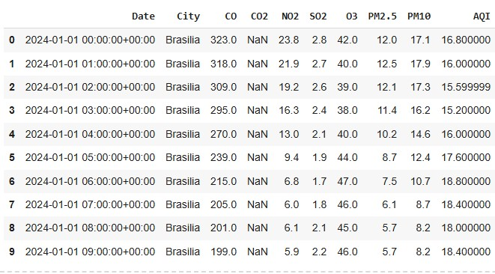
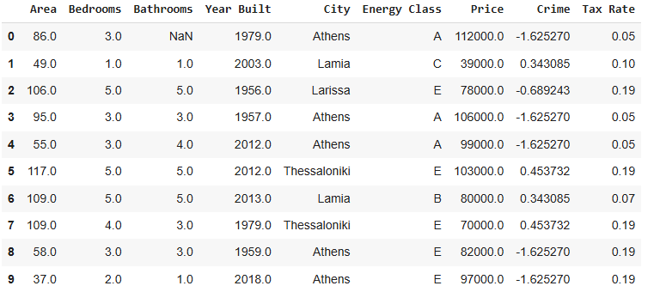
Abstract
Air pollution is a major and public environmental problem. This study analyzes air quality data from various global cities with the goal of predicting the Air Quality Index (AQI) using different machine learning algorithms.
The comparison of models demonstrated that Random Forest provides the most accurate predictions of AQI. The Air Quality Index (AQI) is a standardized indicator that summarizes the concentration of pollutants such as CO, CO2, NO2, SO2, O3, PM2.5, and PM10 into a single value reflecting air quality. Accurate AQI prediction enables timely interventions to protect public health. This study uses real-world air quality measurements to examine the relationship between key pollutants and AQI and applies statistical and machine learning methods to predict AQI levels.

Slide 3

Source the Data
The dataset contains air quality measurements from six major cities: Brasilia, Cairo, Dubai, London, New York, and Sydney. Key variables include CO, CO2, NO2, SO2, O3, PM2.5, PM10, AQI, and timestamps.
- Explore the DataFrame - Handle missing values - Search for duplicates
- Encode categorical variables - Search for outliers
- Data Visualization

Slide 4
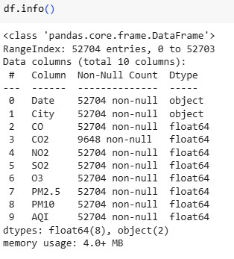
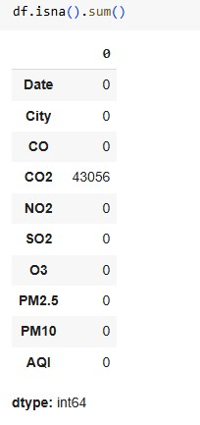
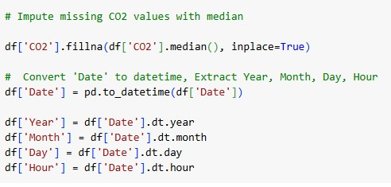
1. Explore the Dataframe
2. Handle missing values

Slide 5

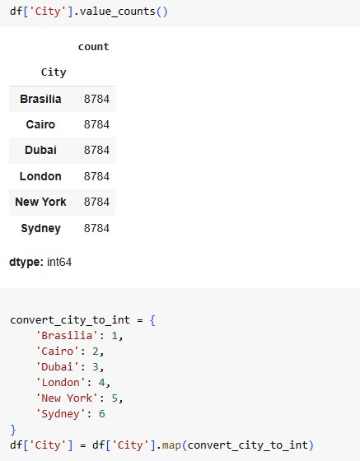
3. Search for duplicates rows
4. Encode categorical variables like City

Slide 6
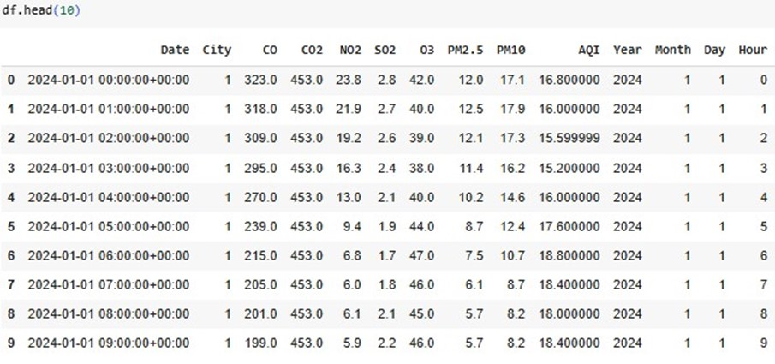
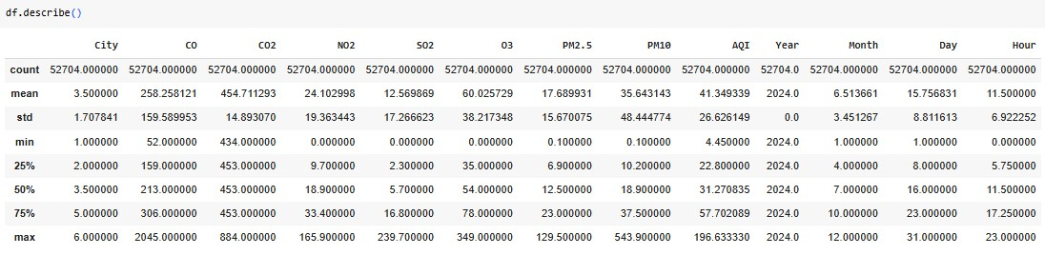

Slide 7
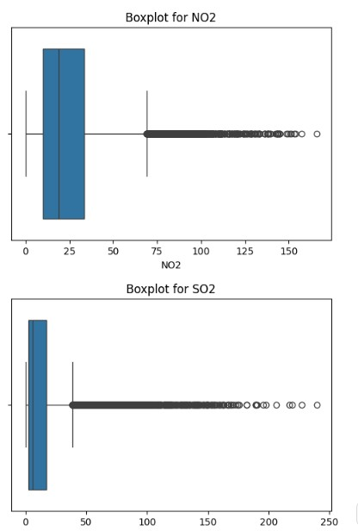
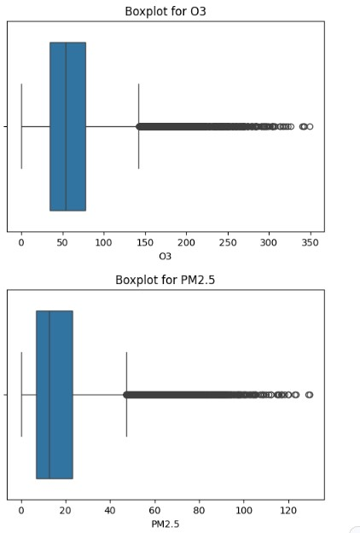
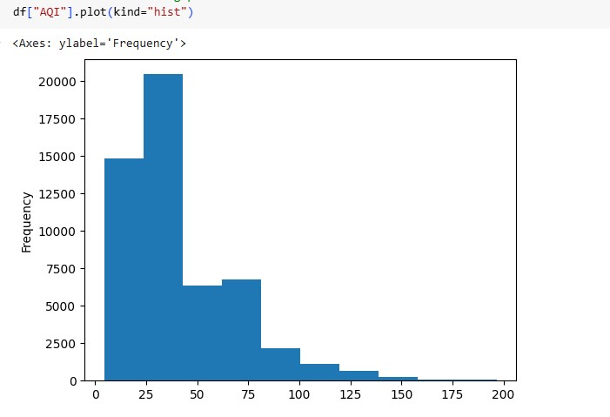
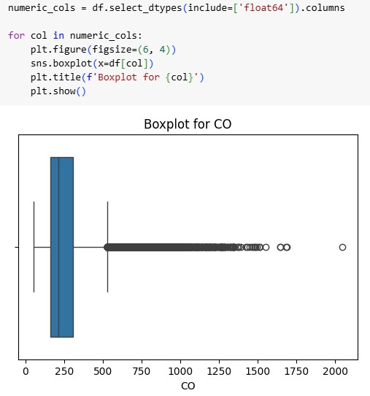
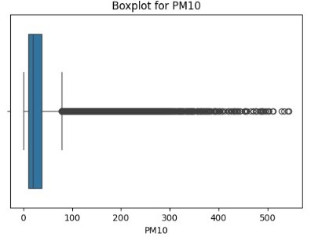
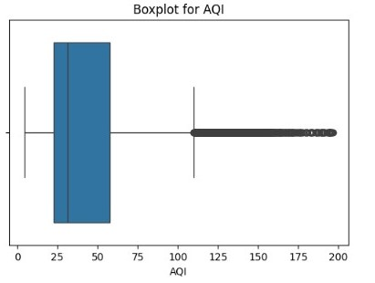
5. check for outliers using plots

Slide 8
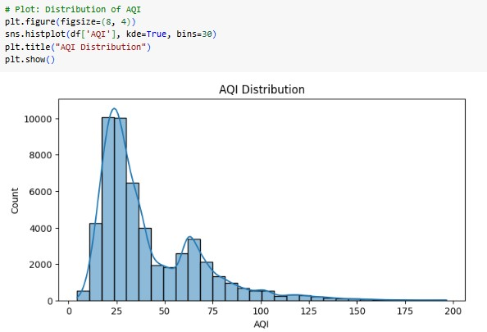
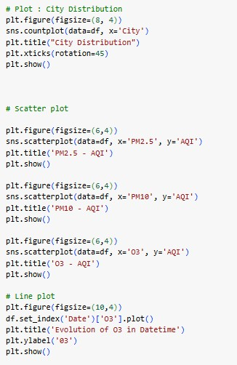
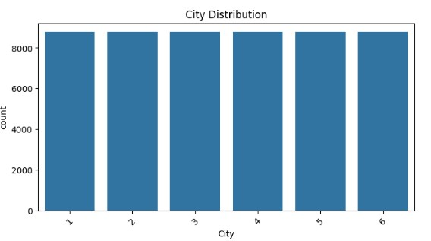
6. Data Visualization
Boxplots, histograms were used to explore data distribution and correlations.

Slide 9
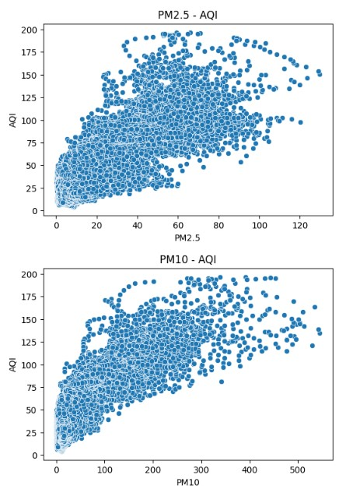
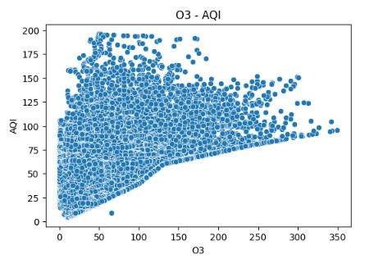
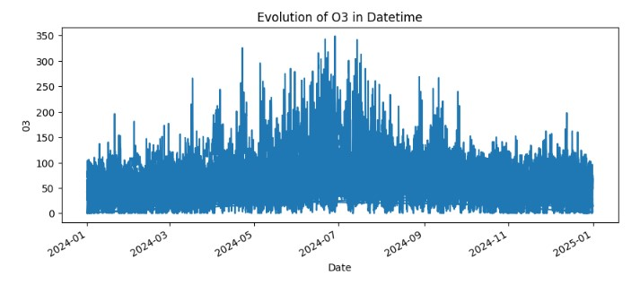
Scatterplots visualized relationships between pollutants and AQI.
Time series plots tracked pollutant evolution over time.

Slide 10
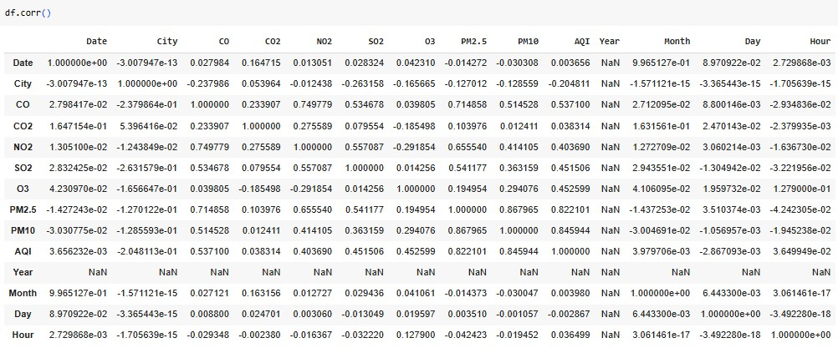
Perform an analysis on the dataset showing how each of the 7 features affects the AQI
Correlation Findings: - Strongest positive correlations with AQI: PM10, PM2.5, CO

Slide 11
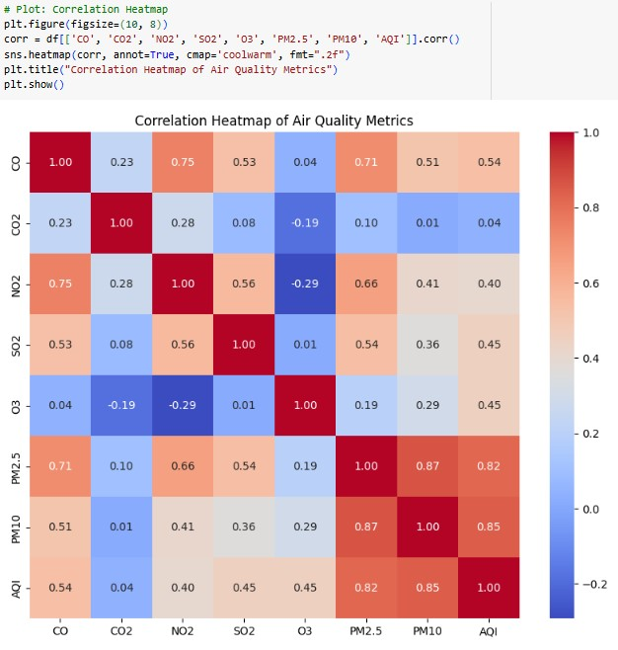

Slide 12
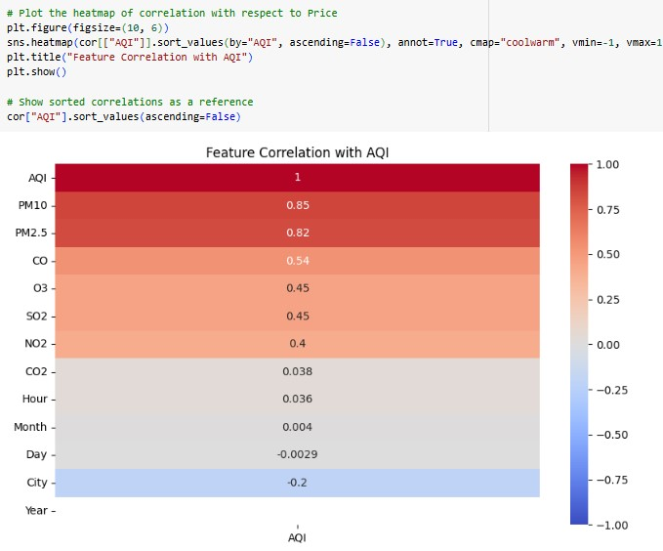
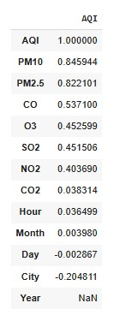

Slide 13
Machine Learning Models
The following regression models were trained and evaluated to predict AQI
- Linear Regression
Decision Tree
Random Forest
XGBoost
Model performance was assessed using:
Root Mean Squared Error (RMSE)
Coefficient of Determination (R²)

Slide 14
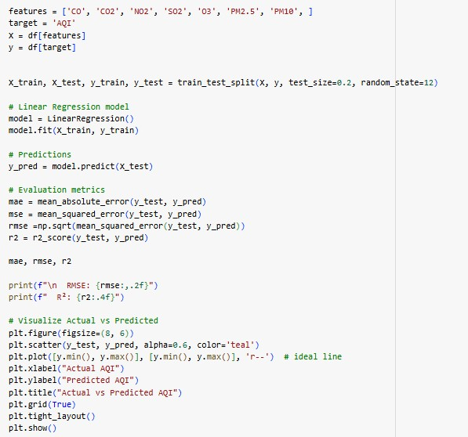
Train a linear regression model to predict the AQI according to the rest of the features.
A Linear Regression model was trained using 80% of the data
and tested on the remaining 20%.

Slide 15

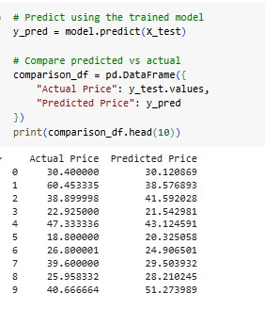
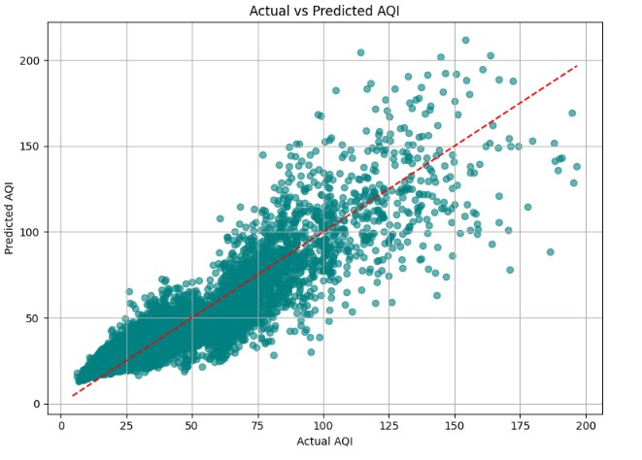
Evaluate the model
The model's AQI predictions are about 11.35 units off from the actual AQI values. 82% of the variation in AQI can be explained by the model

Slide 16
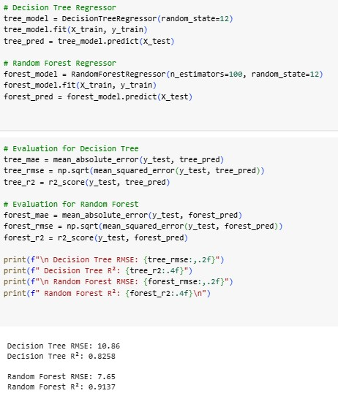
Train a DecisionTree regression & a Random Forest model to predict the AQI according to the rest of the features.
Decision Tree Model - RMSE = 10.86
The model's predictions are off by 10.86 AQI units.
About 82.58% of the variation in the AQI is explained by this model.
Random Forest Model - RMSE = 7.65
This is a significant improvement compared to both Linear Regression and Decision Tree.
The predictions are, on average, only 7.65 AQI units off.
The Random Forest explains 91.37% of the variation in AQI.

Slide 17
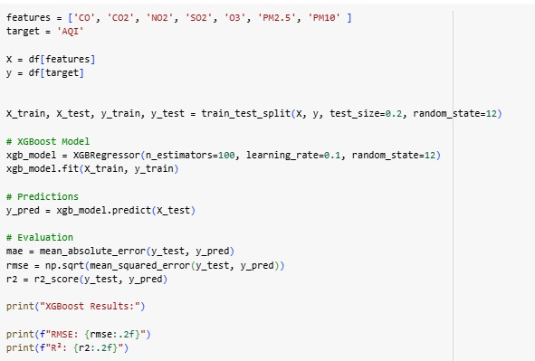

Train a XGBOOST regression model to predict the AQI according to the rest of the features.
XGBOOST Model - RMSE = 8.43
The model's predictions are off by 8.43 AQI units.
About 90% of the variation in the AQI is explained by this model.

Slide 18
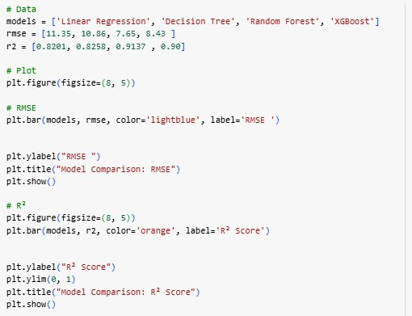
Evaluate the models using RMSE – R2 and compare them

Slide 19
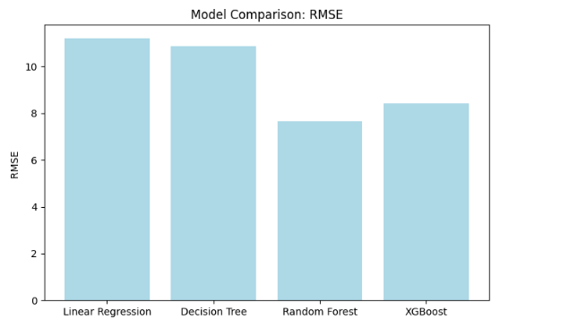
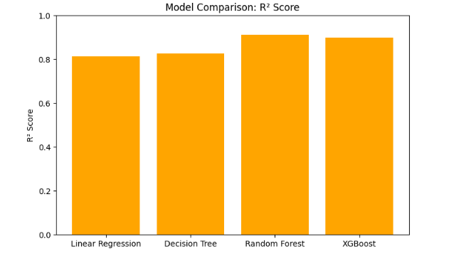
Evaluate the models using RMSE – R2 and compare them

Slide 20
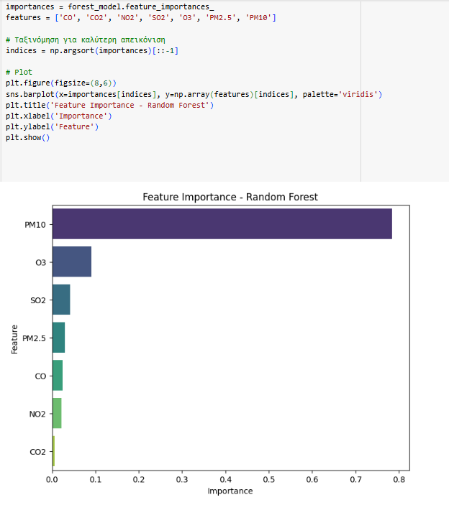
Feature Importance - Random Forest
To better understand the influence of individual pollutants on AQI predictions, a feature importance analysis was performed using the Random Forest model.
The feature_importances_ attribute of the trained model provides a quantitative estimate of how much each input feature contributes to the model's decision-making process.
A bar plot was generated to visualize the relative importance of each pollutant:
The features were sorted in descending order of importance for clearer interpretation.
- The bar chart highlights which pollutants have the greatest impact on AQI predictions, based on how frequently and effectively they are used to split the data within the ensemble of decision trees.
This analysis provides valuable insights into which environmental factors should be prioritized for monitoring and policy-making, with PM2.5, PM10, and O3 typically emerging as the most influential.

Slide 21
Results
Correlation Findings: - PM2.5 , PM10 , O3 , CO2 showed the strongest positive correlation with AQI, indicating that higher levels of these pollutants are associated with poor air quality.
- NO2 and SO2 showed weaker but still relevant positive correlations.
Model Evaluation: Four machine learning models were developed and evaluated to predict AQI based on the pollutant concentrations
Key Observations:
The Random Forest model achieved the best overall performance with the lowest RMSE and the highest R² score, indicating strong predictive power and accurate modeling of the relationship between pollutants and AQI.
The XGBoost model also performed well, with results comparable to Random Forest, highlighting its ability to model complex, non-linear relationships.
Decision Tree and Linear Regression provided moderate performance but were outperformed by the more advanced ensemble models.
The feature importance plot based on the Random Forest model confirms that particulate matter (PM2.5 and PM10) and ozone (O3) are the dominant contributors to AQI variation, underscoring their role as key indicators of air pollution severity."

Slide 22
Conclusions
This study demonstrated the effectiveness of machine learning models for predicting the Air Quality Index (AQI) based on pollutant concentrations across major global cities. Through data preprocessing, exploratory analysis, and correlation studies, key factors contributing to air quality degradation were identified, with PM2.5, PM10, O3, and CO2 showing the strongest relationships with AQI.
Model evaluation revealed that ensemble methods, particularly Random Forest and XGBoost, significantly outperformed simpler models such as Linear Regression and Decision Tree. The Random Forest model achieved the highest accuracy, explaining over 91% of AQI variability and delivering the lowest prediction error.
These findings highlight the potential of advanced machine learning techniques for accurate air quality forecasting, which is crucial for public health protection and environmental management. However, further improvements are possible through hyperparameter tuning and the integration of additional data sources, such as meteorological or traffic data.
Future work will focus on optimizing model parameters, enhancing interpretability, and exploring time-series forecasting approaches to support real-time air quality monitoring and decision-making systems.

